Slide 1
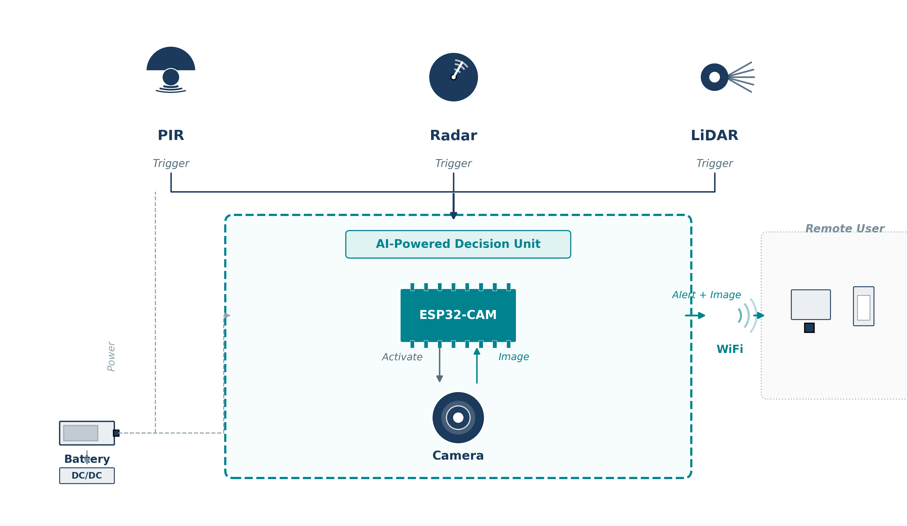
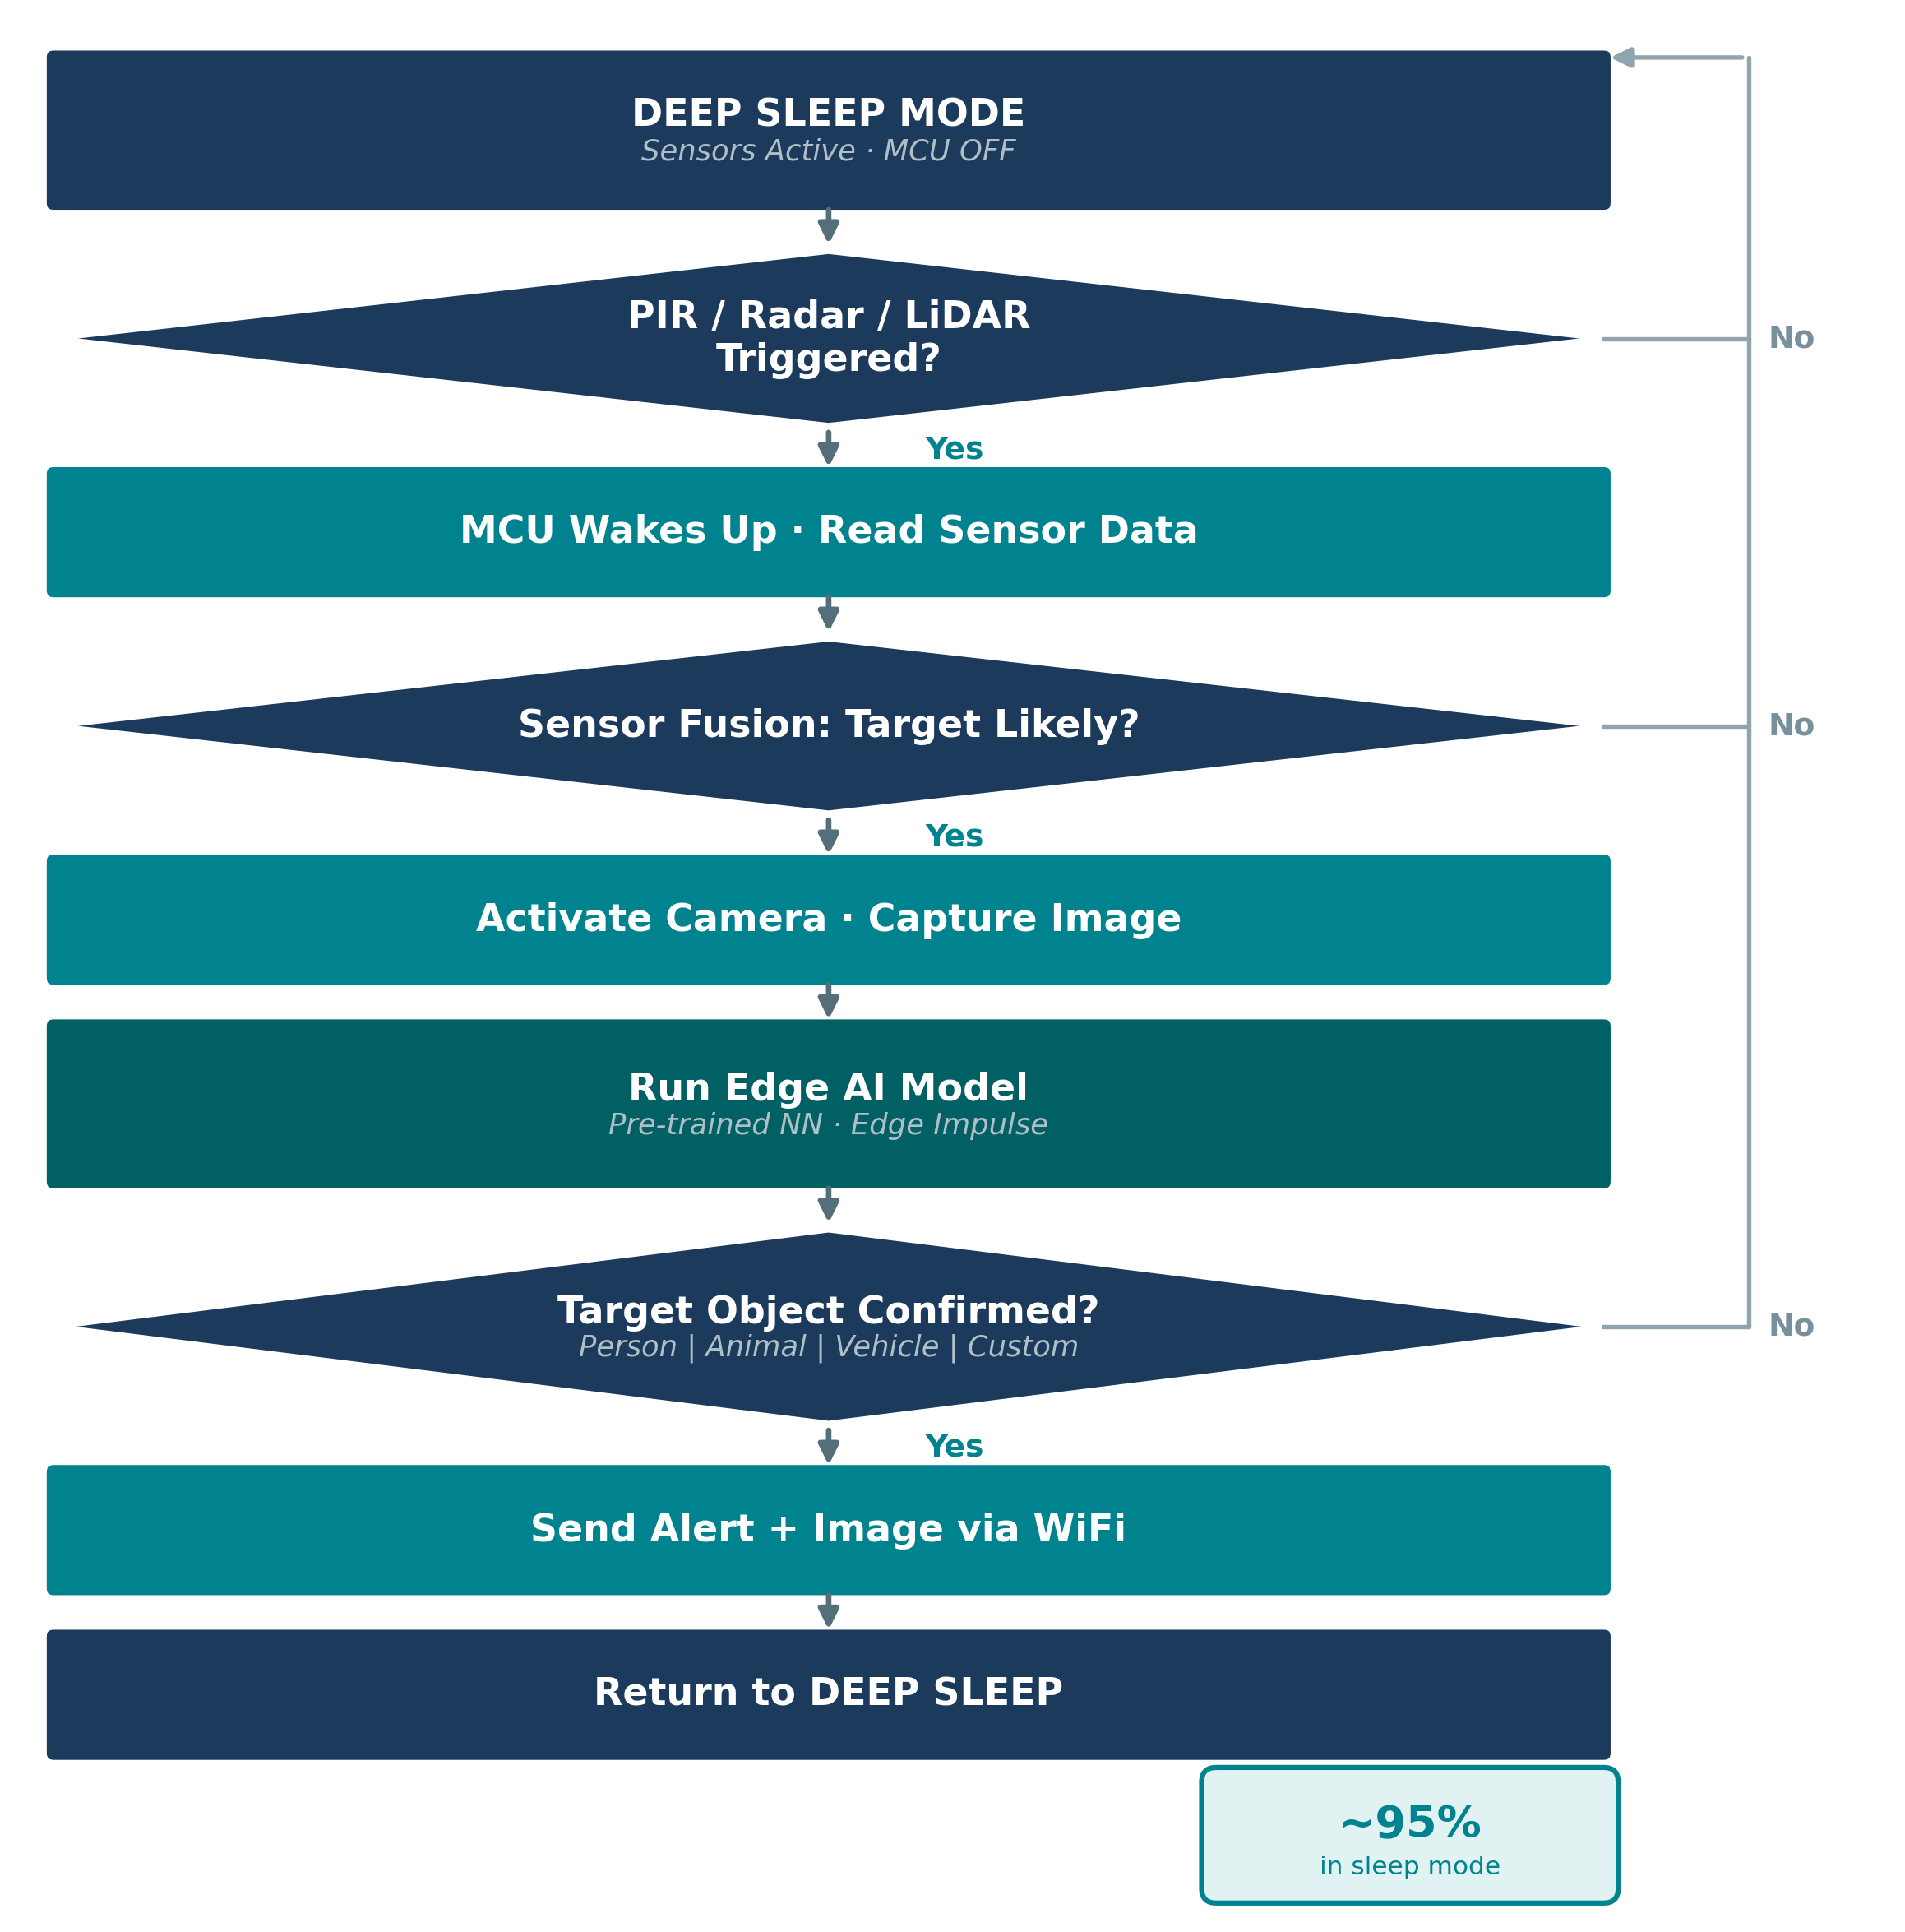
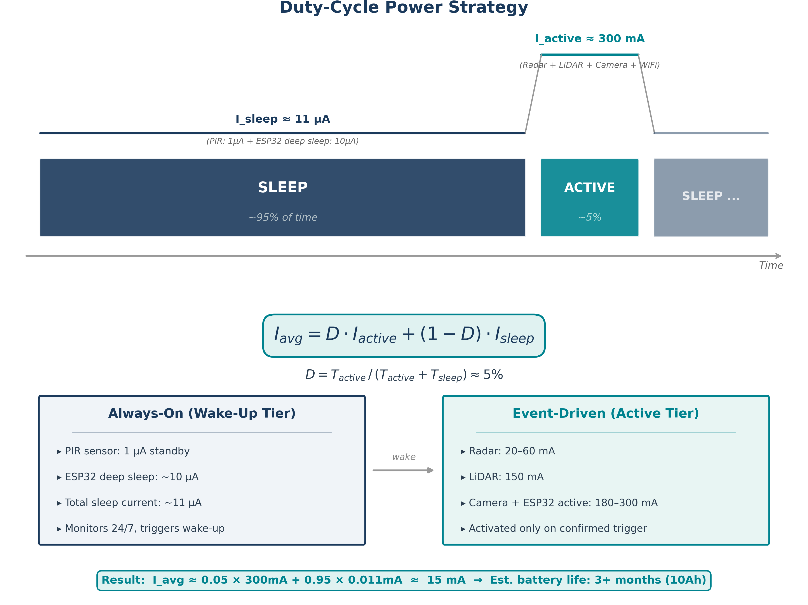


Stand-Alone Low-Power Object Detection System for Open-Field Environments
Amit Sharvit, Shachar Weinberg
Advisor: Hezi Nistani
Project Number: 3335
Introduction
──────────────────────────────
A stand-alone, battery-powered system for detecting objects of interest in open-field environments at ranges up to 30 meters, designed for months-long autonomous operation without infrastructure.
The detection target is fully configurable — person, animal, vehicle, or other object types. The selected target class determines both the sensor fusion weights and the neural network model weights.
An Edge AI model on the MCU evaluates multi-sensor triggers before activating the camera, achieving significant energy savings through intelligent, event-driven wake-up.
System Requirements
▸ Detection range: up to 30 meters
▸ False alarm rate: below 10%
▸ Battery life: 3+ months (10,000 mAh)
▸ All-weather outdoor operation
▸ Configurable target object class
Motivation
──────────────────────────────
Conventional systems rely on continuous power and cellular connectivity — impractical off-grid. Our event-driven approach activates the camera only upon AI-confirmed detection.
One hardware platform serves multiple use cases — perimeter security, wildlife monitoring, traffic control — by swapping the model configuration.
Target Applications
▸ Perimeter security (person detection)
▸ Wildlife monitoring (animal detection)
▸ Traffic & access control (vehicle detection)
▸ Agricultural land monitoring
★ AI-Based Configurable Detection
★ Modular & Compact Design
System Architecture
──────────────────────────────
Decision Algorithm
──────────────────────────────
Duty-Cycle Power Strategy
──────────────────────────────
Two-tier architecture: always-on sensors for wake-up; high-power components on confirmed triggers only.
Conclusions
──────────────────────────────
▸ Configurable detection: person / animal / vehicle / custom
▸ Target selection adjusts sensor weights + NN model weights
▸ Edge AI achieves ~95% energy savings vs. naive trigger
▸ Est. 3+ months battery life (10Ah)
▸ WiFi alerts with real-time web dashboard
Future Work
▸ Field testing with multiple target classes
▸ ML model optimization per deployment scenario
▸ Power profiling & duty-cycle optimization
References
[1] Espressif ESP32 Datasheet [2] Edge Impulse

